Slide 1


Hii, Iam Siddhika
Welcome to Power BI Series
Part -35

Slide 2



Today Content
We focus only on the most used and important Dax Functions
I’m soo Excited.
Are you ready guys?
Meet DAX
COMMON FUNCTION CATEGORIES
4. FILTER FUNCTIONS (FEW MORE)
SELECTEDVALUE
EXAMPLE USING SELECTEDVALUE TO CREATE DYNAMIC TITLE

Slide 3

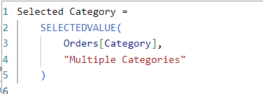

SELECTEDVALUE
The SELECTEDVALUE function in DAX returns the value that is currently selected in a column if there is only one value selected. If no value or more than one value is selected, it returns an alternate result specified by the user, or BLANK if no alternate result is specified.
Check this
Syntax
SELECTEDVALUE(<columnName>[, <alternateResult>])
Here just i’m taking for example to understand.
_{Example} Suppose we have an "Orders" table with columns "Category" and "Sales Amount". We want to create a measure that returns the selected
category or "Multiple Categories" if more than one category is selected.
This Dax returns the selected value from the "Category" column if only one category is selected. If no category or more than one category is selected, it returns "Multiple Categories".

Slide 4

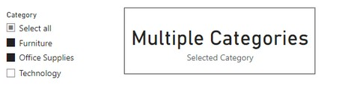

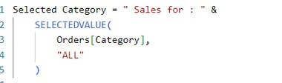

Visual Example for better understanding
Understood? Check next slide for dynamic title
This function is particularly useful in scenarios where you need to handle single value selections cleanly, such as in reports, dashboards, or calculations that depend on user interactions.
Here I’m taking 1 Scenarios to Use SELECTEDVALUE for our understanding. Dynamic Titles and Labels in Reports:
When creating reports, you might want to show dynamic titles or labels that change based on the user's selection. SELECTEDVALUE can be used to display the selected item or a default message if multiple items are selected.
Here we create a dynamic title that displays the selected category from a slicer, or shows "ALL" if no category or multiple categories are selected?
Using this formula, We can create a dynamic title that will update based on the category selected by the user in the slicer. If one category is selected, the title will show "Sales for: [Selected Category]". If no categories or multiple categories are selected, it will show "Sales for: ALL".

Slide 5
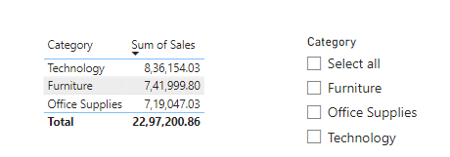
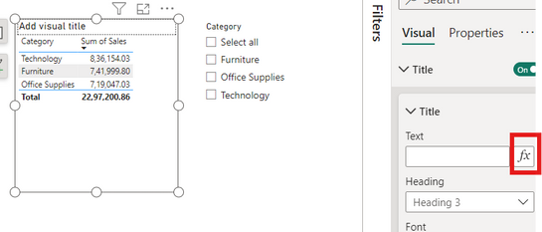
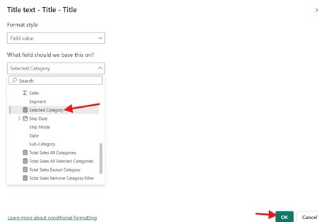
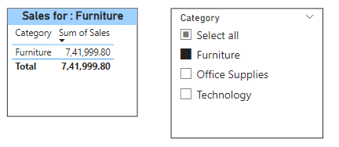
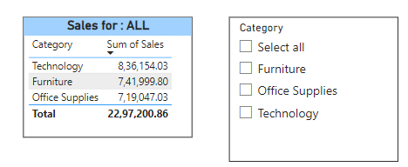
After creating the Selected Category measure ,next steps to create dynamic Title
Take category ,sales column in a visual to use dynamic title and category column in a slicer
Understood?

Slide 6


Thank you for joining me today to learn about Part -35 of Power BI!
Remember, Learning DAX is key to unlocking the full potential of Power BI for insightful reporting and visualization.
Stay tuned for more insights and tips on Power BI in our next Series.
Follow
Siddhika Shah

